Slide 1
SONET Network Elements
A.SANGEETHA

Slide 2
Regenerator
The regenerator is an STE that regenerates attenuated signals.
A regenerator or amplifier is needed when, due to the long distance between multiplexers, the signal level in the fiber gets attenuated and becomes too low to drive a receiver.
The regenerator clocks itself off of the received signal and replaces the SOH bytes before retransmitting the signal. The LOH, payload, and POH are not altered.
The regenerator is sometimes called a repeater.
Regenerators can be cascaded to extend the reach of the optical-fiber system.
However, nonlinear impairments must be taken into consideration while cascading regenerators.

Slide 3
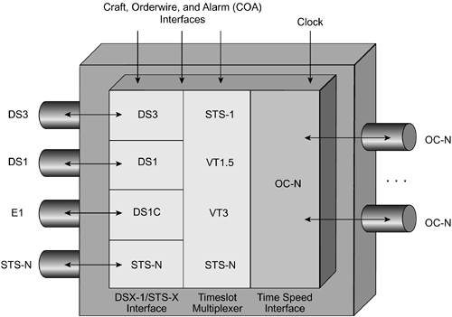
Terminal Multiplexer

Slide 4
Terminal Multiplexer
The terminal multiplexer (TM) is a PTE that can concentrate or aggregate DS1s, DS3s, E1s, E3s, STS-Ns, and STM-Ns. An implementation with two TMs represents a SONET link with a section, line, and path all in one link. The schematic of a TM is shown in Figure 5-21.
Various PDH signals, such as DS1, E1, DS3, are mapped to their associated SONET electrical payloads in the TM. For example, DS1 signals are mapped to VT1.5s, and DS3 signals are mapped to STS-1 SPEs.
An EO conversion takes place, and the OC-N signals are launched into the fiber. The reverse happens during signal reception. In practice, the TM Is an ADM operating in terminal mode. The TM is analogous to the channel bank in the TDM world and allows lower-speed user access to the SONET network.

Slide 5
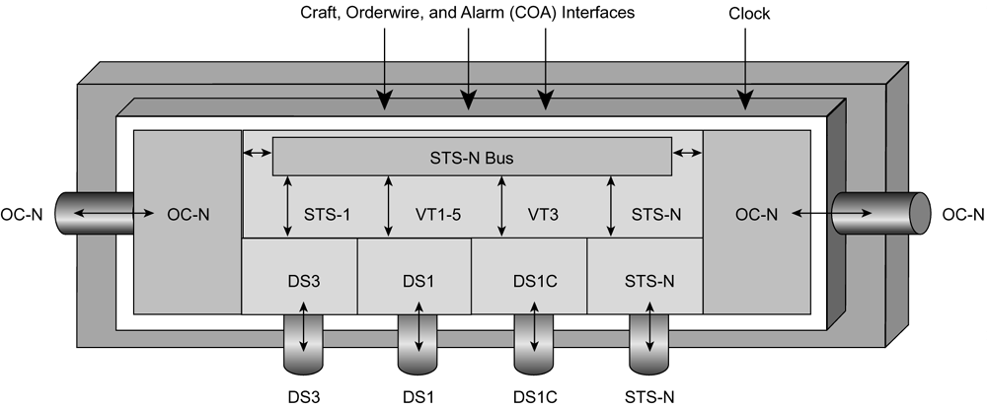
Add/Drop Multiplexer
An ADM is a PTE that can multiplex or demultiplex various signals to or from an OC-N signal. At an add/drop site, only those signals that need to be accessed are dropped or inserted. The remaining traffic continues through the NE without requiring special pass-through units or other signal processing. Signals can also be looped or terminated at the ADM

Slide 6
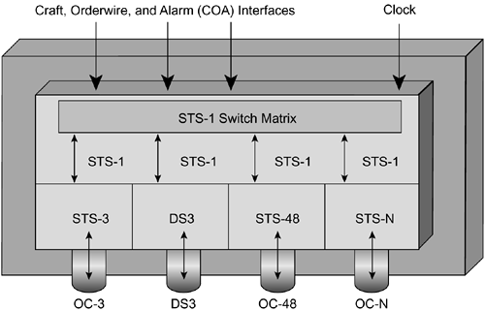
BROADBAND CROSSCONNECT
The broadband digital cross-connect (BDCS) can make two-way cross-connections at the DS3, STS-1, and STS-Nc levels.
It can interface various SONET signals and DS3s.
The BDCS is the synchronous equivalent of a DS3 digital access and cross-connect system (DACS) and supports hub-network architectures.

Slide 7
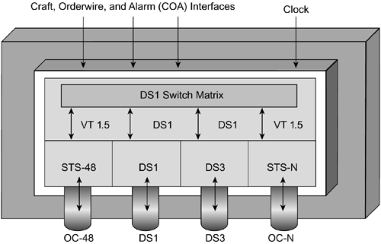
Wideband Digital Cross-Connect

Slide 8
Wideband Digital Cross-Connect
The WDCS is suitable for DS1-level grooming applications at hub locations. One major advantage of the WDCS is that less demultiplexing and multiplexing is required because only the required tributaries are accessed and switched.
Because SONET is synchronous, the low-speed tributaries are visible and accessible within the STS-1 signal. Therefore, the required tributaries can be accessed and switched without demultiplexing, which isn't possible with existing TDM digital cross-connects.
The WDCS also cross-connects the constituent DS1s between DS3 terminations, as well as between DS3 and DS1 terminations.
The features of the WDCS make it useful in several applications. Because the WDCS can automatically cross-connect VTs and DS1s, it can be used as a network management system and for grooming at hub locations.

Slide 9
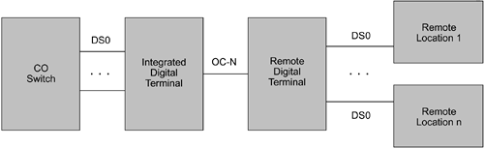
Digital Loop Carrier

Slide 10
Digital Loop Carrier
From a voice perspective, the DLC may be considered a concentrator of low-speed services before they are brought into the local CO for switching or distribution. The concentration can be achieved using a combination of multiplexing and intelligent GR.303 concentration.
If concentration were not performed, the number of subscribers that a CO could serve would be limited by the number of physical lines served by the CO.
The DLC itself is actually a system of multiplexers and switches designed to perform concentration from the remote terminals to the CO. The DLC devices are referred to as remote fiber terminals (RFTs) by several optical vendors.

Slide 11
Multiservice Provisioning Platforms (MSPPs)
Multiservice provisioning platforms (MSPPs) combine the functionality of the SONET ADM, BDCS, and WDCS NEs in a single platform. The platform also integrates Ethernet services and DWDM functionality in the box.
The MSPP provides TDM solutions with interfaces, such as DS1, DS3, EC1, and data solutions with 10/100/1000 Ethernet solutions along with OC-3 to OC-192 optical transport bit rates including integrated DWDM wavelengths.
The MSPP supports various SONET topologies including ring, linear point-to point, linear add/drop, star, and hybrid topologies. The protection and restoration choices include unidirectional path-switched ring (UPSR), two-fiber and four-fiber bidirectional line-switched ring (BLSR), 1+1 APS, unprotected span, and the Cisco Path Protected Mesh Networking (PPMN).
The MSPP devices are easily configurable using integrated graphical user interface (GUI)-based tools and are fully manageable using element management systems.

Slide 12
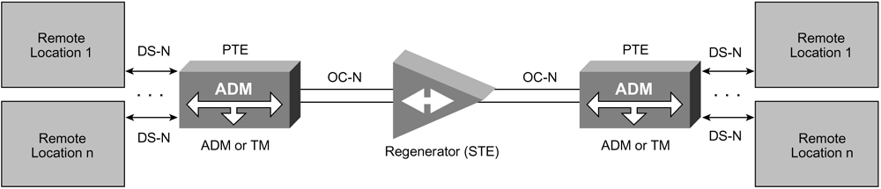
SONET Topologies
Point-to-Point Topology
Point-to-point topologies are created by connecting two SONET PTEs back to back over dark fiber. a point-to-point deployment involves two PTE ADMs or TMs linked by fiber with or without an STE regenerator in the link. The TM could act as a DS1 concentrator and transport the DS1s over an OC-N link. The synchronous island can coexist within an asynchronous domain. Point-to-point topologies are extremely popular to provide storage-area network (SAN) interconnectivity between datacenters. Albeit, SAN protocols, such as ESCON, FICON, or Fibre Channel, use 1.25- or 2.125-Gbps channels over DWDM systems. The system always terminates the link using a next-generation TM, such as an MSPP.

Slide 13
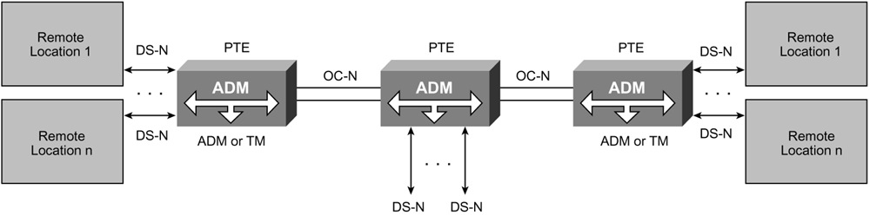
Point-to-Multipoint Topology
ADM is a unique NE specifically designed for this task. the ADM is typically placed along a SONET link to facilitate adding and dropping of tributary or STS channels at intermediate points in the network.
The point-to-multipoint topology is also referred to as a linear add/drop architecture. This topology is implemented for medium- and long-haul linear SONET architectures, where the service provider might have to add or drop circuits on the way to the destination.

Slide 14
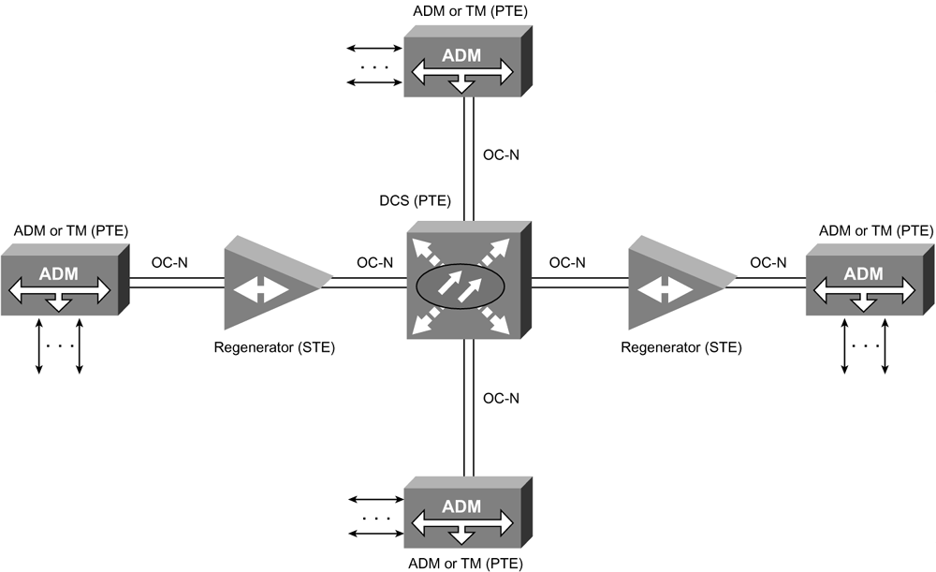
Hub Topology

Slide 15
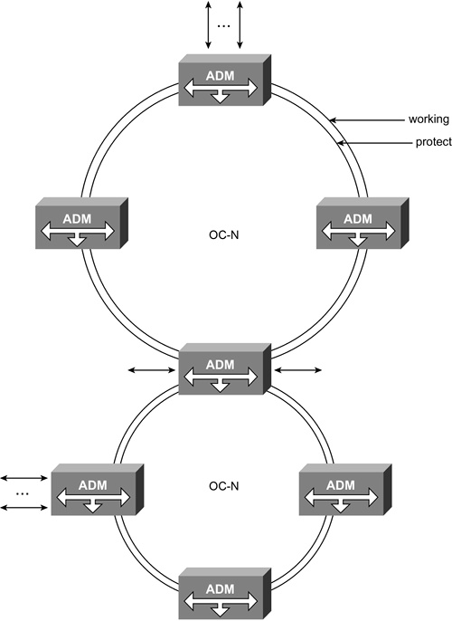
Ring Topology

Slide 16
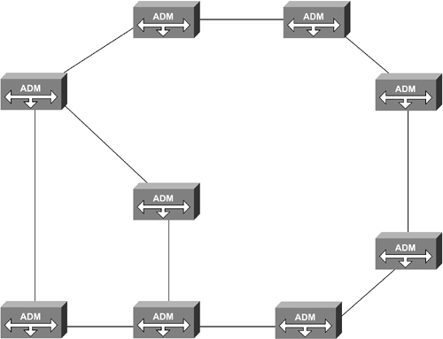
Mesh Topology

Slide 17
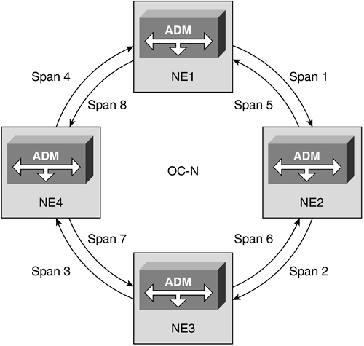
SONET Ring Architectures
Unidirectional Versus Bidirectional Rings

Slide 18
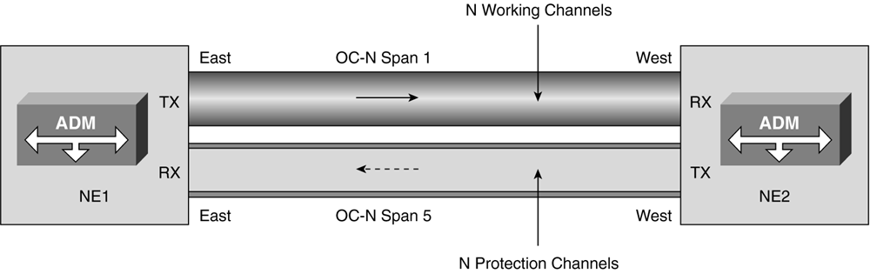
Two-Fiber Unidirectional Ring

Slide 19
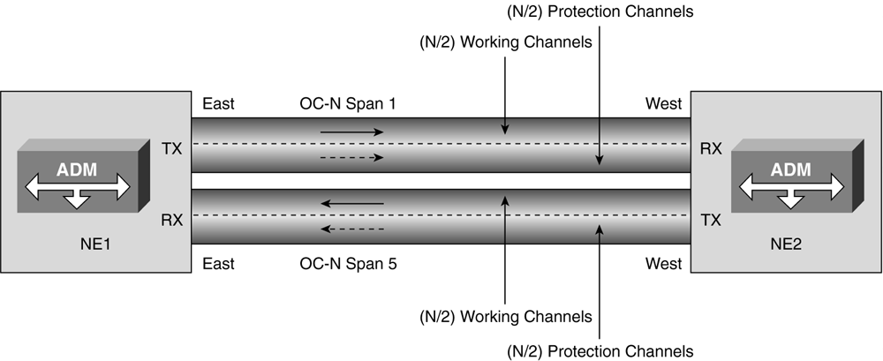
Two-Fiber Bidirectional Ring

Slide 20
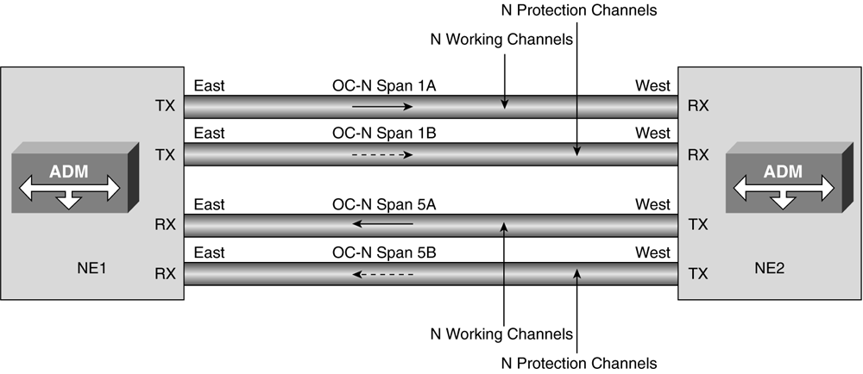
Four-Fiber Bidirectional Ring

Slide 21
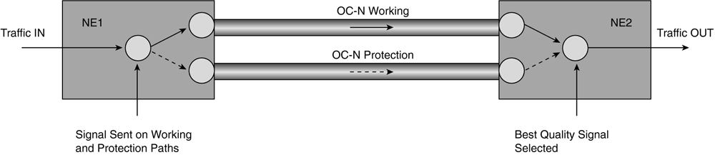
Path Switching

Slide 22
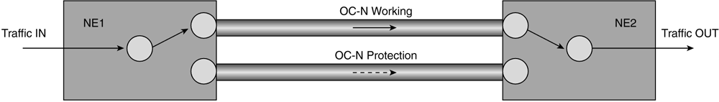
Line Switching

Slide 23
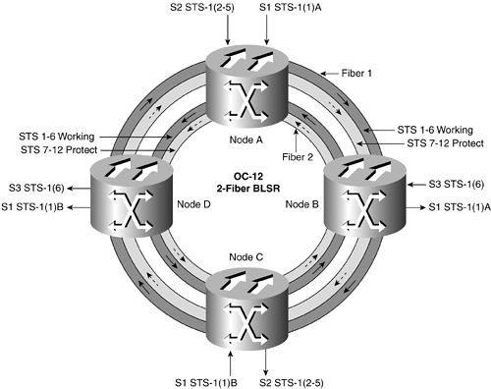
Two-Fiber BLSR

Slide 24
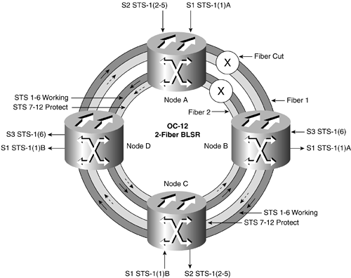
Two-Fiber BLSR Protection

Slide 25
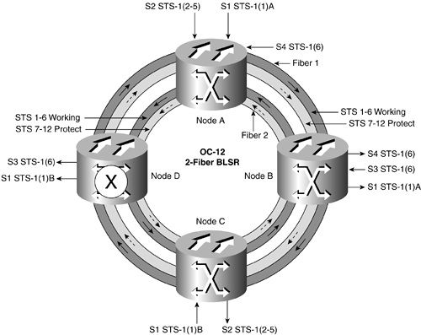
BLSR Node Failure

Slide 26
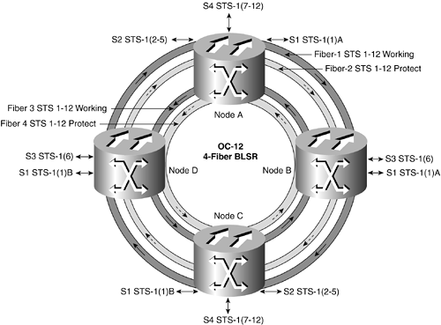
Four-Fiber BLSR

